Slide 1
ELEC5620M Embedded Microprocessor System Design
Unit 2.1 Task Recap
Unit 2.2
Dr David Cowell Module Leader d.m.j.cowell@leeds.ac.uk
Prof Steven Freear

Slide 2
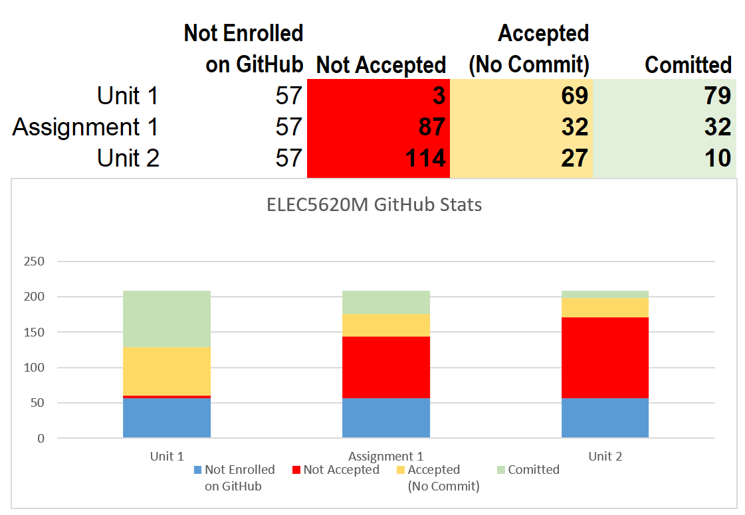
GitHub Classrooms
Commit code and push from GitHub desktop (See GitHub Intro lecture). Check GitHub.com code shows.

Slide 3
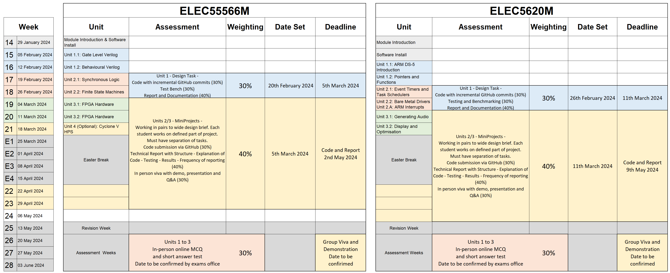
ELEC5620M Assessment Summary
ELEC5566M

Slide 4
ELEC5620M Embedded Microprocessor System Design
Assignment 1 Deadline 11th March 2024 at 2pm
Dr David Cowell Module Leader d.m.j.cowell@leeds.ac.uk
Prof Steven Freear

Slide 5
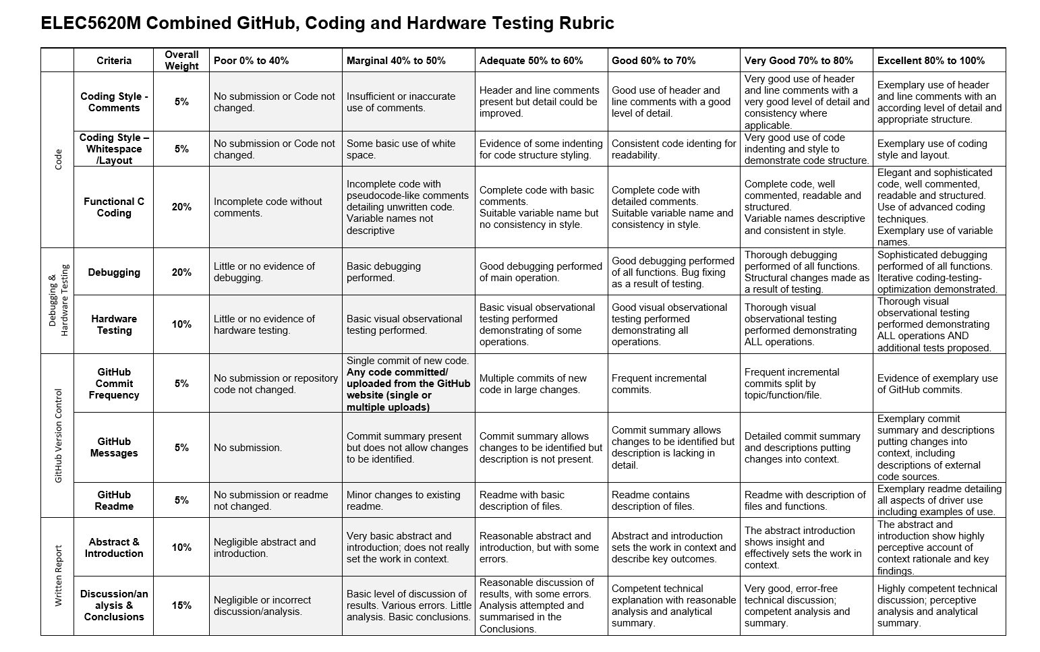
ELEC5620M Combined GitHub, Coding and Hardware Testing Rubric

Slide 6
Unit 1.2:
Task recap

Slide 7
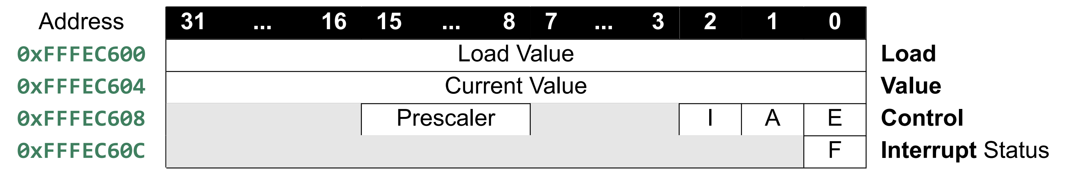
Arm A9 Private Timer Registers

Slide 8
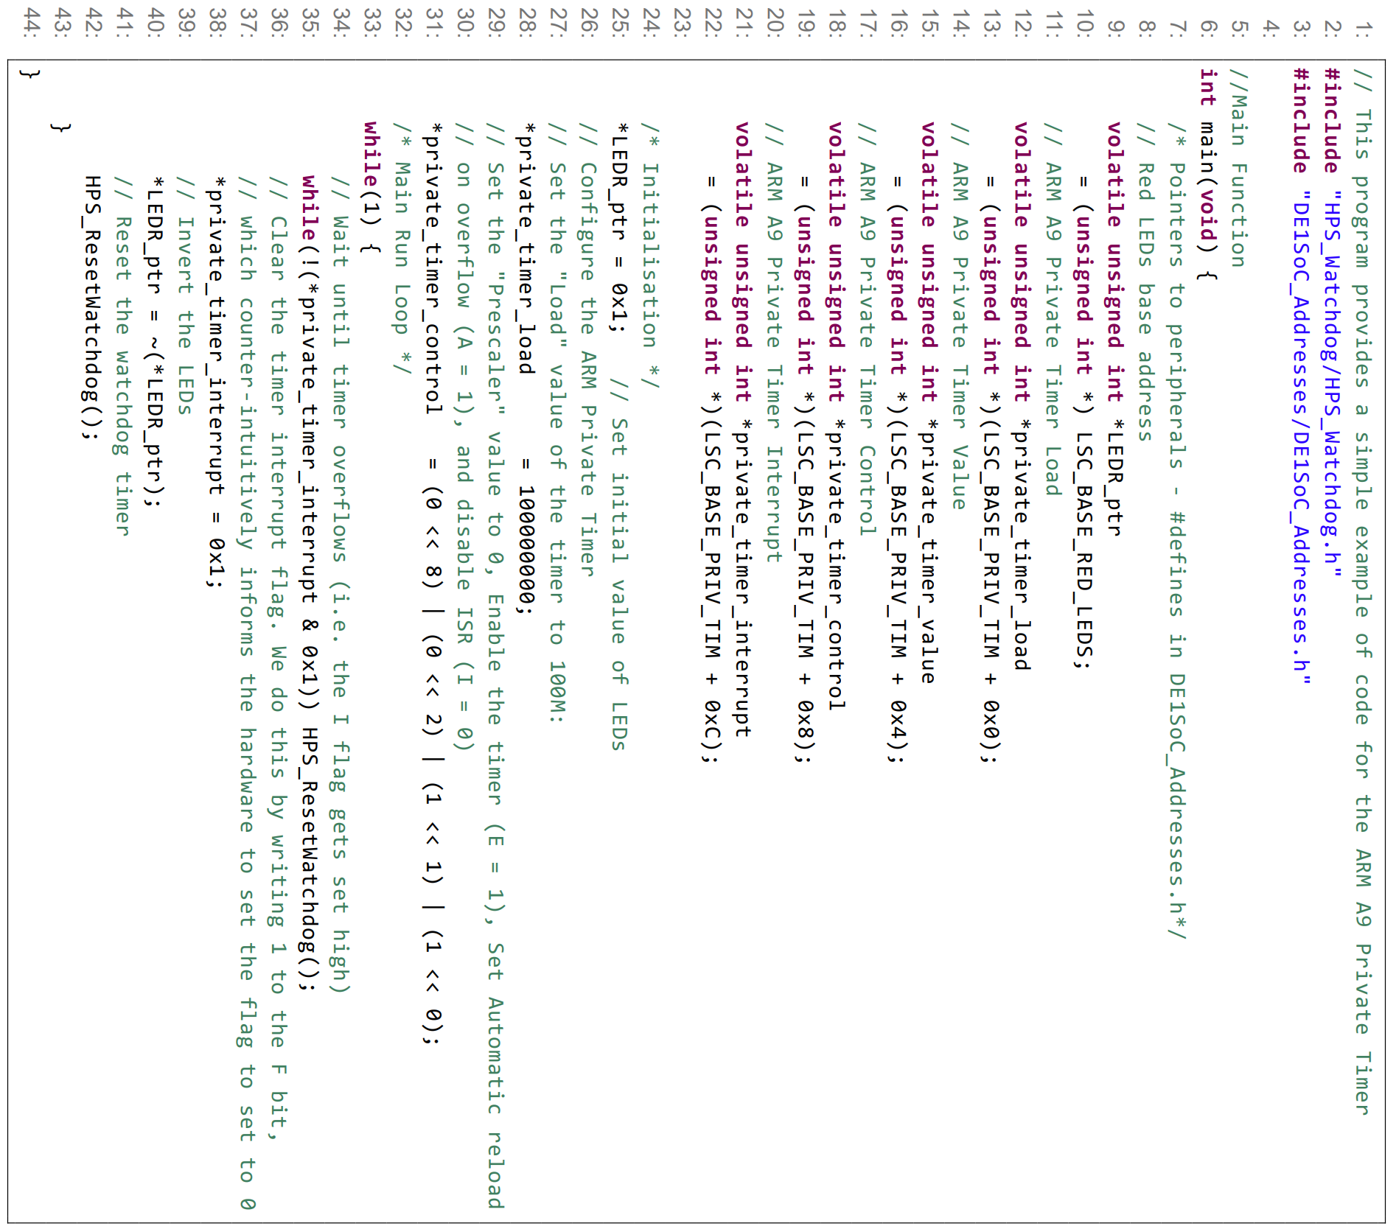
A9 Private Timer Memory Mapped Interface
#define LSC_BASE_PRIV_TIM ((unsigned char*)0xFFFEC600)

Slide 9
A9 Private Timer Memory Mapped Interface
#define LSC_BASE_PRIV_TIM ((unsigned char*)0xFFFEC600)
// ARM A9 Private Timer Value
volatile unsigned int *private_timer_value = (unsigned int *)(((unsigned char*)0xFFFEC600) + 0x4);
// ARM A9 Private Timer Value
volatile unsigned int *private_timer_value = (unsigned int *)(0xFFFEC604);

Slide 10
A9 Private Timer Task 1 – Timer clock frequency?

Slide 11
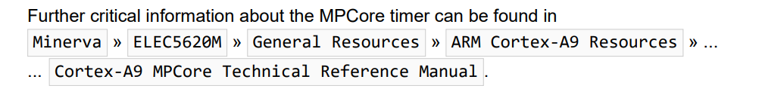
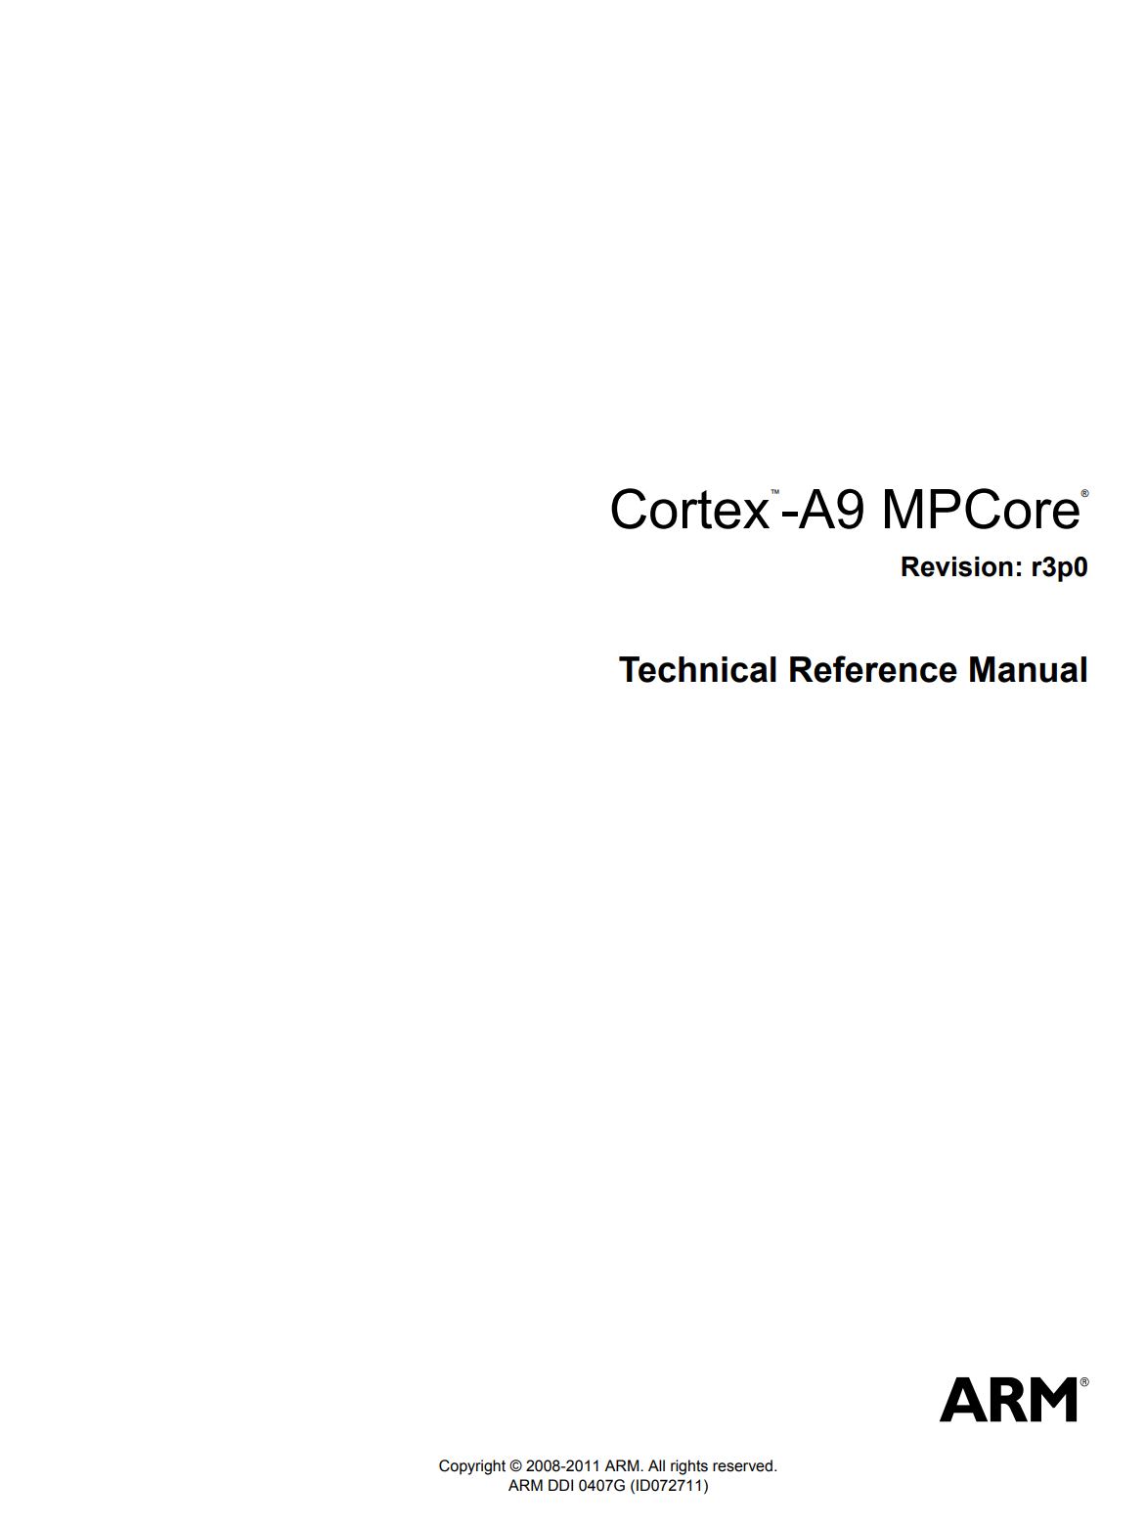
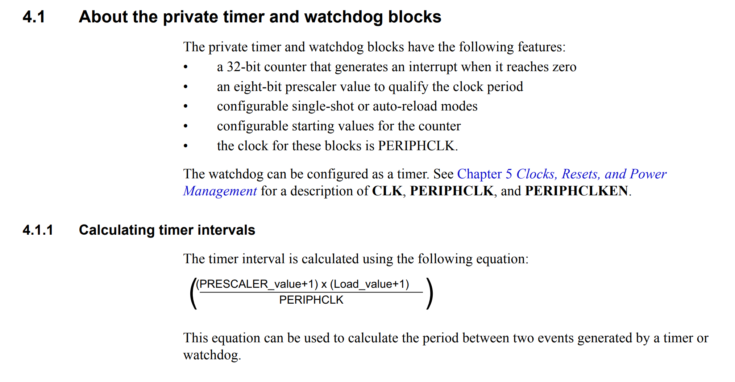
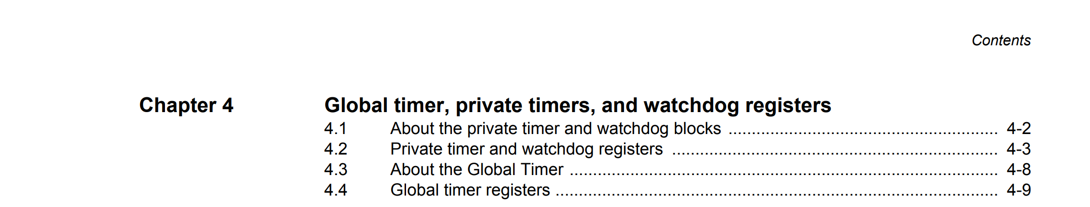
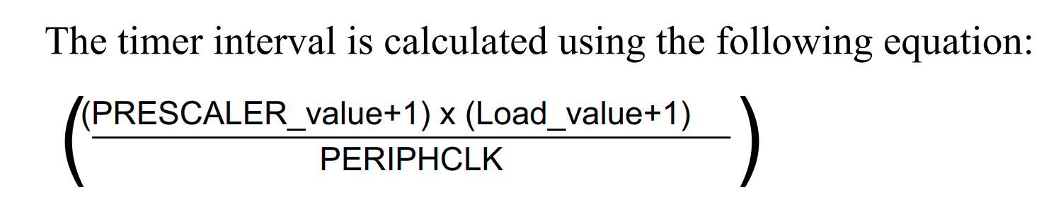
A9 Private Timer Task 1 – Timer clock frequency?

Slide 12
A9 Private Timer Task 1 – Timer equation

Slide 13
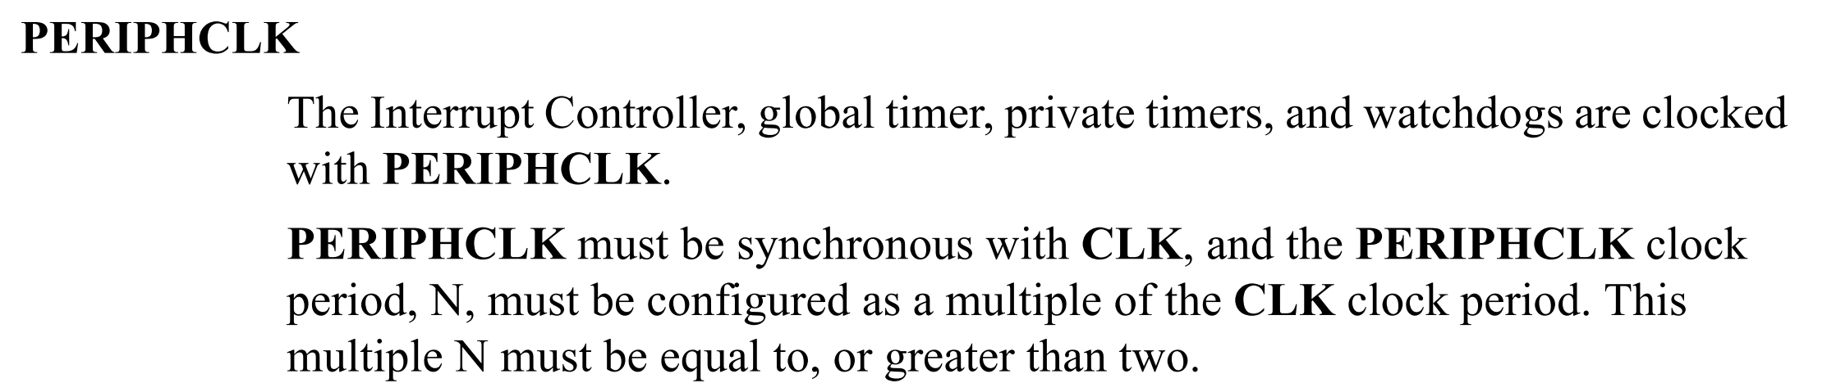
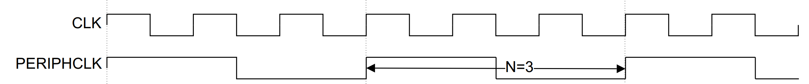
A9 Private Timer Task 1 – Timer clock frequency

Slide 14
A9 Private Timer Task 1 – Timer clock frequency
16 timer periods = 7.36 seconds … 1 period = 0.46 seconds
32 timer periods = 14.23 seconds … 1 period = 0.44 seconds

Slide 15
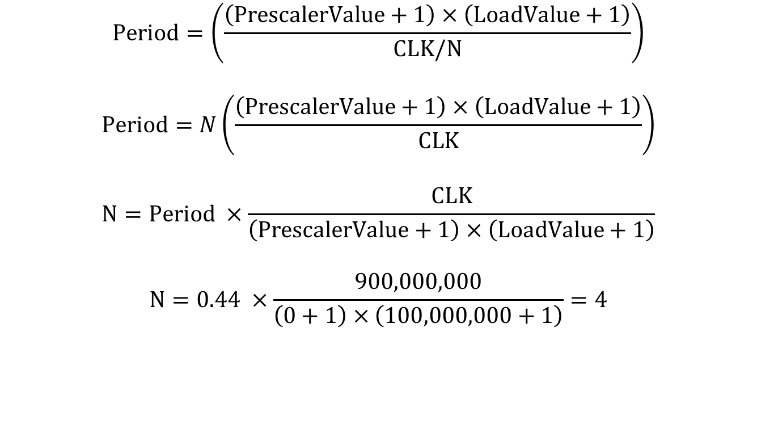
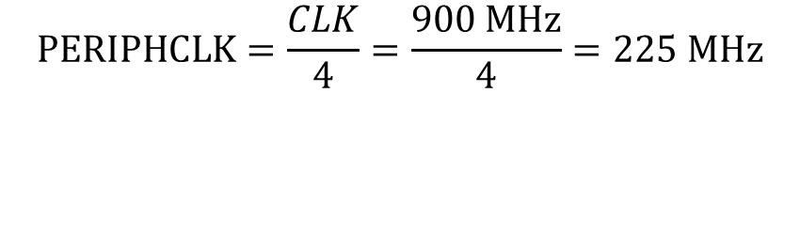
A9 Private Timer Task 1 – Timer clock frequency
16 timer periods = 7.36 seconds … 1 period = 0.46 seconds
32 timer periods = 14.23 seconds … 1 period = 0.44 seconds
$$Period=\left(\frac{\left(PrescalerValue+1\right)×\left(LoadValue+1\right)}{CLK/N}\right)$$
$$Period=N\left(\frac{\left(PrescalerValue+1\right)×\left(LoadValue+1\right)}{CLK}\right)$$
$$N=Period ×\frac{CLK}{\left(PrescalerValue+1\right)×\left(LoadValue+1\right)}$$
$$N=0.44 ×\frac{900,000,000}{\left(0+1\right)×\left(100,000,000+1\right)}=4$$
Work out the clock frequency that drives the timer
$$PERIPHCLK=\frac{CLK}{4}=\frac{900 MHz}{4}=225 MHz$$

Slide 16
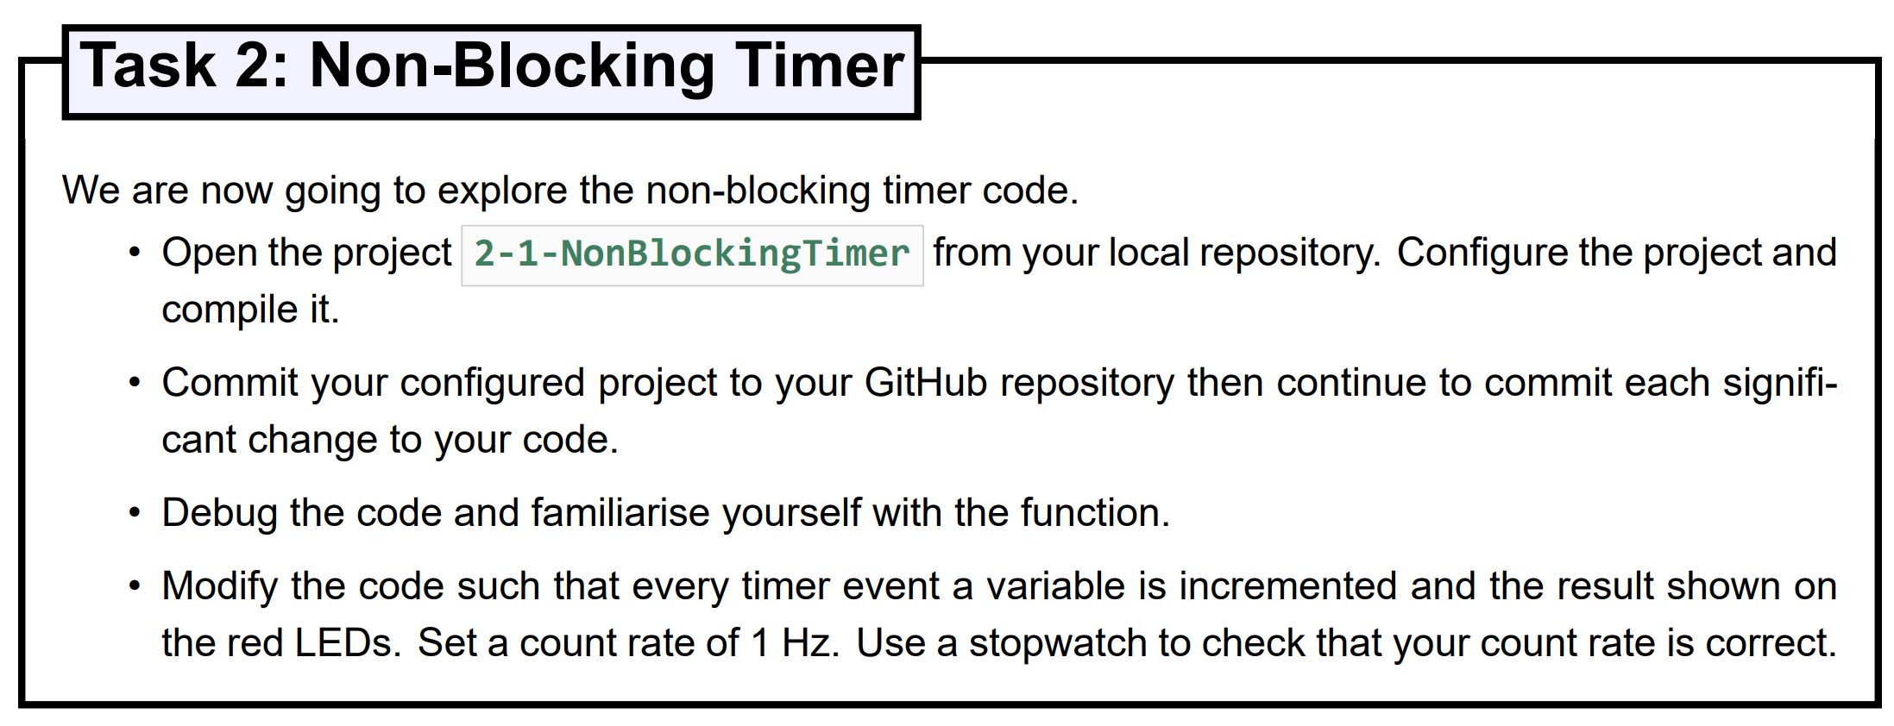
A9 Private Timer Task 2 – Non-Blocking Timer - Count rate
1 second count rate Load_value = 249999999 !

Slide 17
A9 Private Timer Task 2 – Non-Blocking Timer
const unsigned int blinkPeriod = 224999999;
unsigned int counter; //Create a local counter variable and initialise
counter = 0;
while(1) {
unsigned int currentTimerValue = *private_timer_value;
if ((lastBlinkTimerValue - currentTimerValue) >= blinkPeriod) {
counter = counter+1; //Increment the counter
lastBlinkTimerValue = lastBlinkTimerValue - blinkPeriod;
}
if (*private_timer_interrupt & 0x1) {
// If the timer interrupt flag is set, clear the flag
*private_timer_interrupt = 0x1;
}
*LEDR_ptr = counter & 0x3FF; // Use bitmasking to ensure only valid bits are set.
HPS_ResetWatchdog();
}

Slide 18
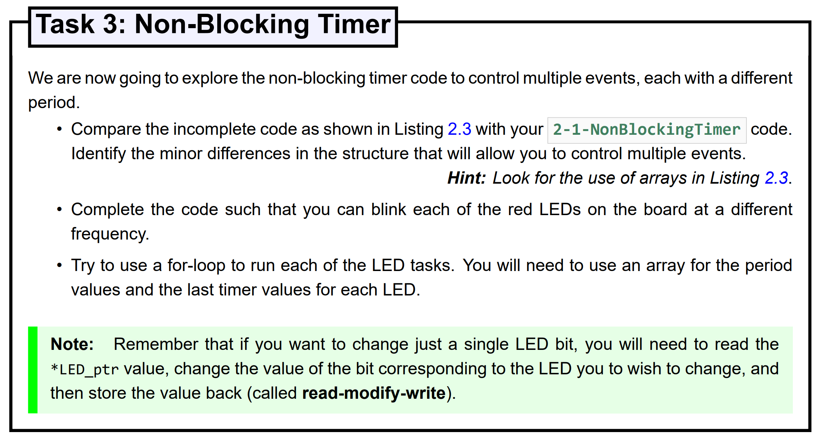
Task 3

Slide 19
Task 3 - Possible solution
/*
* This program provides a non-blocking example of code for the ARM A9 Private Timer
*/
#include "HPS_Watchdog/HPS_Watchdog.h"
#include "DE1SoC_Addresses/DE1SoC_Addresses.h"
#define MAX_LEDS 3
//Main Function
int main(void) {
/* Pointers to peripherals */
// Red LEDs base address
volatile unsigned int *LEDR_ptr = (unsigned int *) LSC_BASE_RED_LEDS;
// ARM A9 Private Timer Load
volatile unsigned int *private_timer_load = (unsigned int *)(LSC_BASE_PRIV_TIM + 0x0);
// ARM A9 Private Timer Value
volatile unsigned int *private_timer_value = (unsigned int *)(LSC_BASE_PRIV_TIM + 0x4);
// ARM A9 Private Timer Control
volatile unsigned int *private_timer_control = (unsigned int *)(LSC_BASE_PRIV_TIM + 0x8);
// ARM A9 Private Timer Interrupt
volatile unsigned int *private_timer_interrupt = (unsigned int *)(LSC_BASE_PRIV_TIM + 0xC);
/* Initialisation */
// Configure the ARM Private Timer
// Set the "Load" value of the timer to max value:
*private_timer_load = 0xFFFFFFFF;
// Set the "Prescaler" value to 0, Enable the timer (E = 1), Set Automatic reload
// on overflow (A = 1), and disable ISR (I = 0)
*private_timer_control = (0 << 8) | (0 << 2) | (1 << 1) | (1 << 0);
/* Main Run Loop */
/* Local Variables */
unsigned int lastBlinkTimerValue[MAX_LEDS] = {0};
unsigned int task;
unsigned int currentTimerValue;
//Set Timer Rate
const unsigned int blinkPeriod[MAX_LEDS] = {224999999,22499999,2249999}; // PERIPHCLK=225MHz
while(1) {
// Check if it is time to blink
for(task = 0; task < MAX_LEDS; task++){
// Read the current time
currentTimerValue = *private_timer_value;
if ((lastBlinkTimerValue[task] - currentTimerValue) >= blinkPeriod[task]) {
//Invert the required LED
*LEDR_ptr = (*LEDR_ptr ^ (1 << task));
//Update the last blink timer values
lastBlinkTimerValue[task] = lastBlinkTimerValue[task] - blinkPeriod[task];
}
}
if (*private_timer_interrupt & 0x1) {
// If the timer interrupt flag is set, clear the flag
*private_timer_interrupt = 0x1;
}
// Finally, reset the watchdog timer.
HPS_ResetWatchdog();
}
}

Slide 20
Task 3 - Possible solution
/* Initialisation */
// Configure the ARM Private Timer
// Set the "Load" value of the timer to max value:
*private_timer_load = 0xFFFFFFFF;
// Set the "Prescaler" value to 0, Enable the timer (E = 1), Set Automatic reload
// on overflow (A = 1), and disable ISR (I = 0)
*private_timer_control = (0 << 8) | (0 << 2) | (1 << 1) | (1 << 0);
/* Main Run Loop */
/* Local Variables */
unsigned int lastBlinkTimerValue[MAX_LEDS] = {0};
unsigned int task;
unsigned int currentTimerValue;
//Set Timer Rate
const unsigned int blinkPeriod[MAX_LEDS] = {224999999,22499999,2249999}; // PERIPHCLK=225MHz
while(1) {
// Check if it is time to blink
for(task = 0; task < MAX_LEDS; task++){
// Read the current time
currentTimerValue = *private_timer_value;
if ((lastBlinkTimerValue[task] - currentTimerValue) >= blinkPeriod[task]) {
//Invert the required LED
*LEDR_ptr = (*LEDR_ptr ^ (1 << task));
//Update the last blink timer values
lastBlinkTimerValue[task] = lastBlinkTimerValue[task] - blinkPeriod[task];
}
}
if (*private_timer_interrupt & 0x1) {
// If the timer interrupt flag is set, clear the flag
*private_timer_interrupt = 0x1;
}
// Finally, reset the watchdog timer.
HPS_ResetWatchdog();
}
}

Slide 21
Task 3 - Possible solution
while(1) {
// Check if it is time to blink
for(task = 0; task < MAX_LEDS; task++){
// Read the current time
currentTimerValue = *private_timer_value;
if ((lastBlinkTimerValue[task] - currentTimerValue) >= blinkPeriod[task]) {
//Invert the required LED
*LEDR_ptr = (*LEDR_ptr ^ (1 << task));
//Update the last blink timer values
lastBlinkTimerValue[task] = lastBlinkTimerValue[task] - blinkPeriod[task];
}
}
if (*private_timer_interrupt & 0x1) {
// If the timer interrupt flag is set, clear the flag
*private_timer_interrupt = 0x1;
}
// Finally, reset the watchdog timer.
HPS_ResetWatchdog();
}
}

Slide 22
Unit 2.2
Bare Metal Drivers
Servo Motor Driver
A9 Private Timer Driver Task

Slide 23
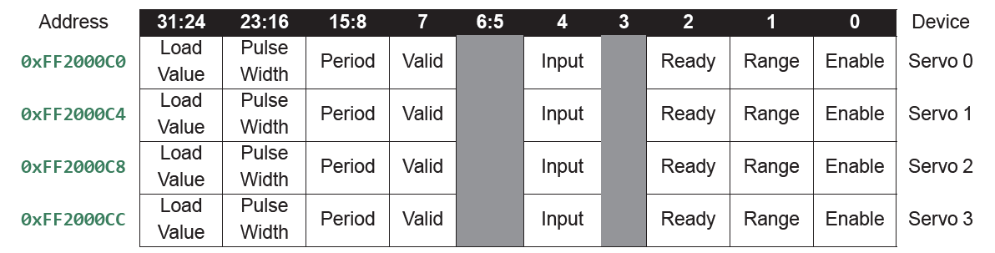
Task: Servo Driver
Servo_initialise(0xFF2000C0), //Initialise Servo Controller
Servo_enable(0, true), //Enable Servo 0.
Servo_pulseWidthRange(0, true), //Double pulse width.

Slide 24
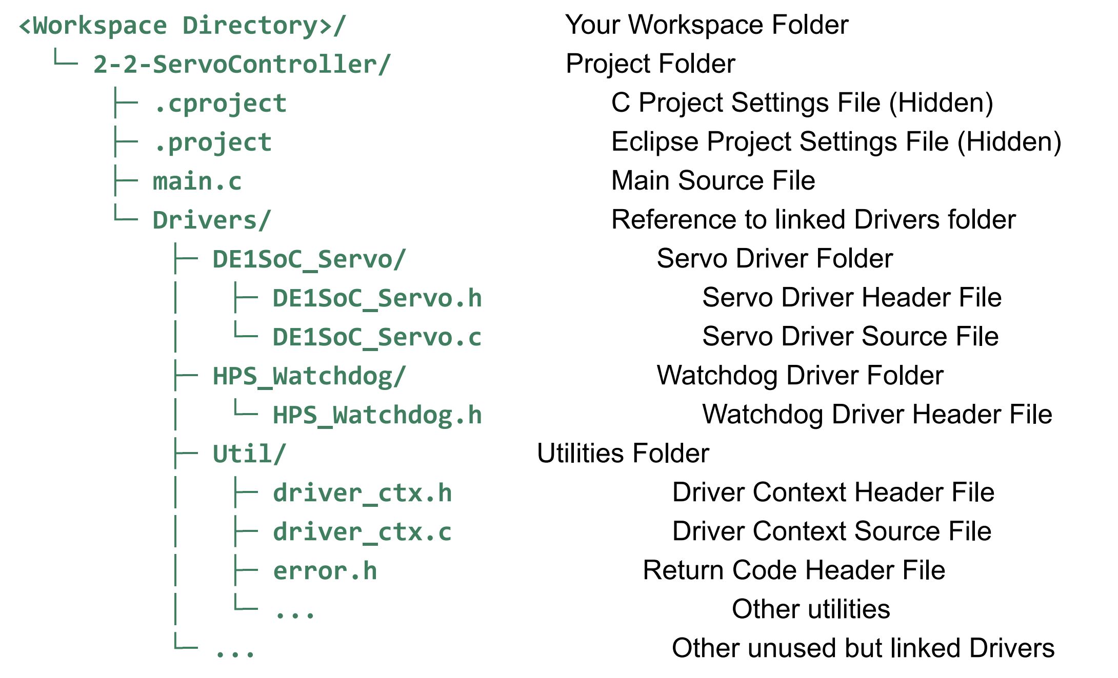
Bare Metal Drivers Structure

Slide 25
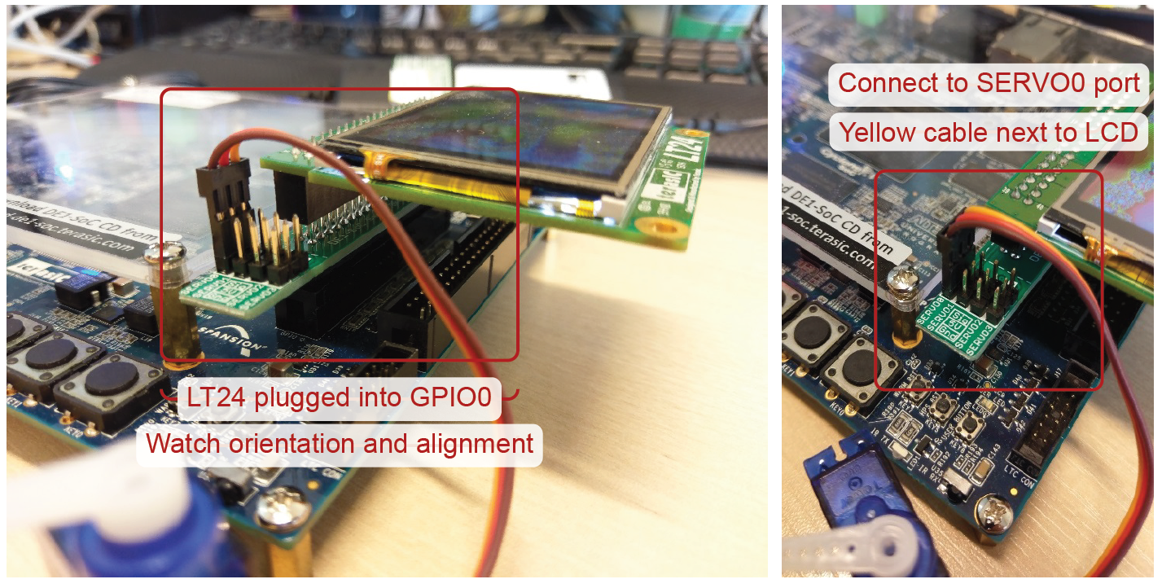
Servo and LCD Connection

Slide 26
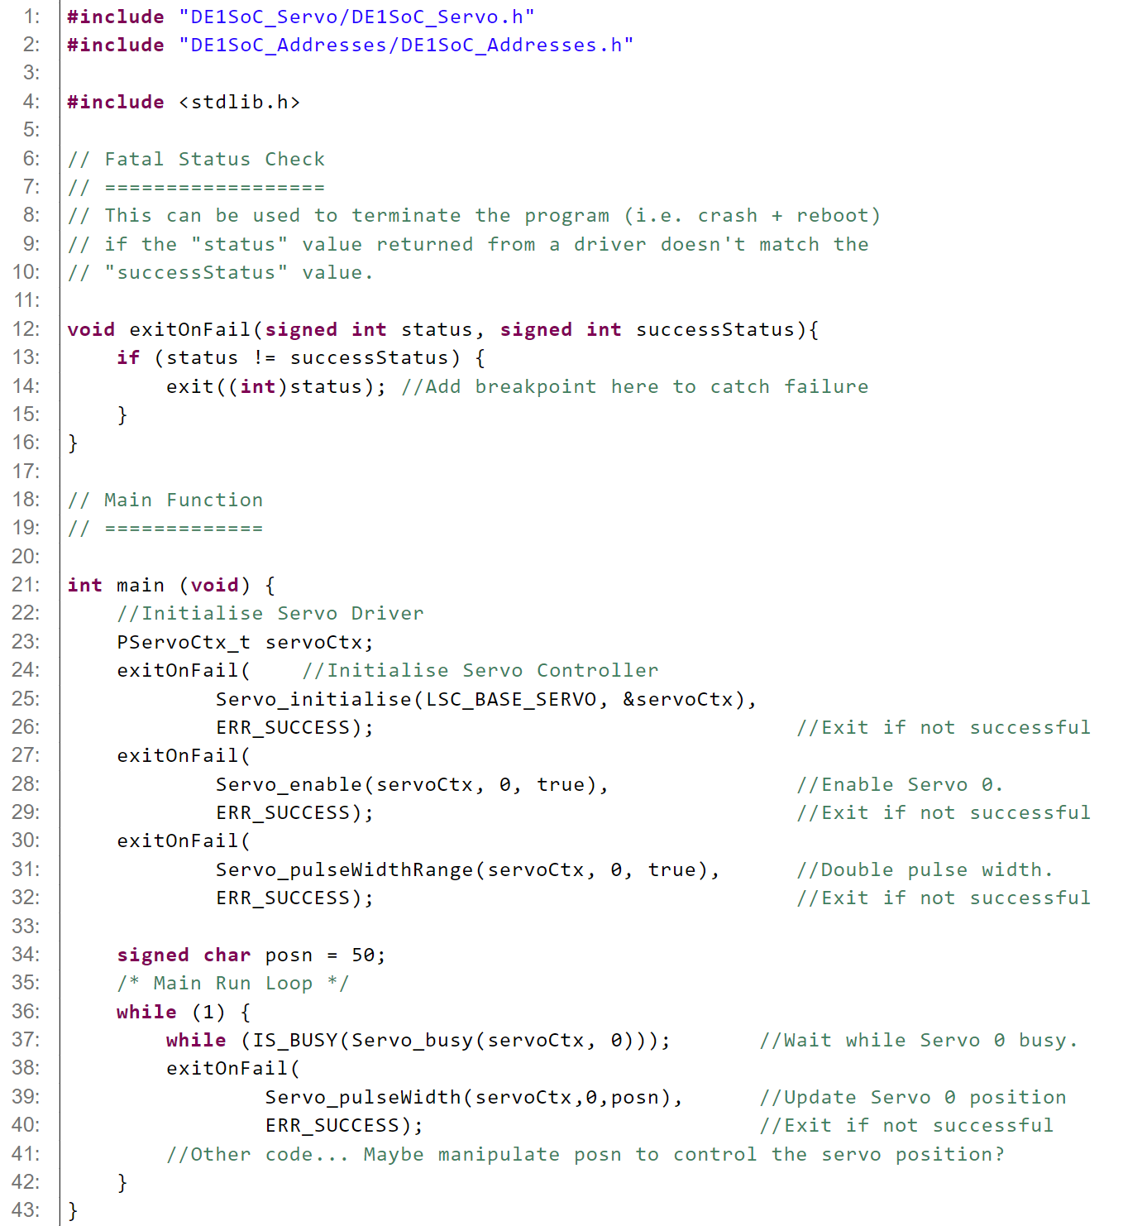
Example Servo Driver use
Useful debugging tool – allows break point upon a driver error

Slide 27
Example Servo Driver use
Custom datatype to contain all information about our Servo Driver!
Simple initialisation functions
Simple operational functions
No pointers manually coded in the main function!

Slide 28
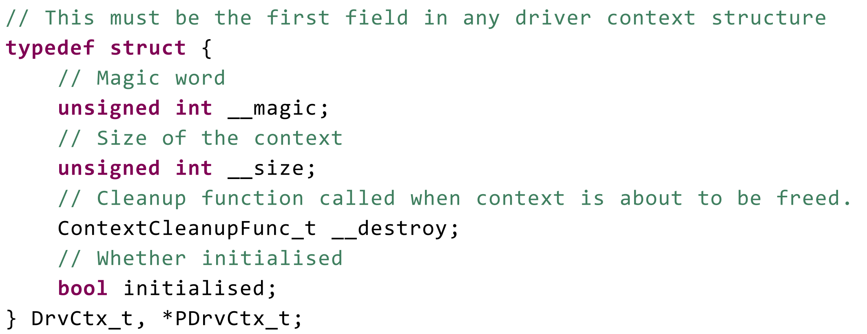
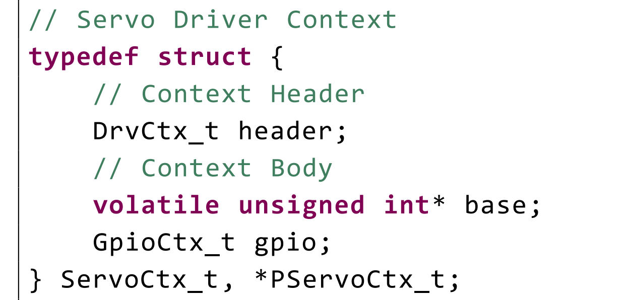
Driver Contexts
DE1SoC_Servo.h
Utils/driver_ctx.h

Slide 29
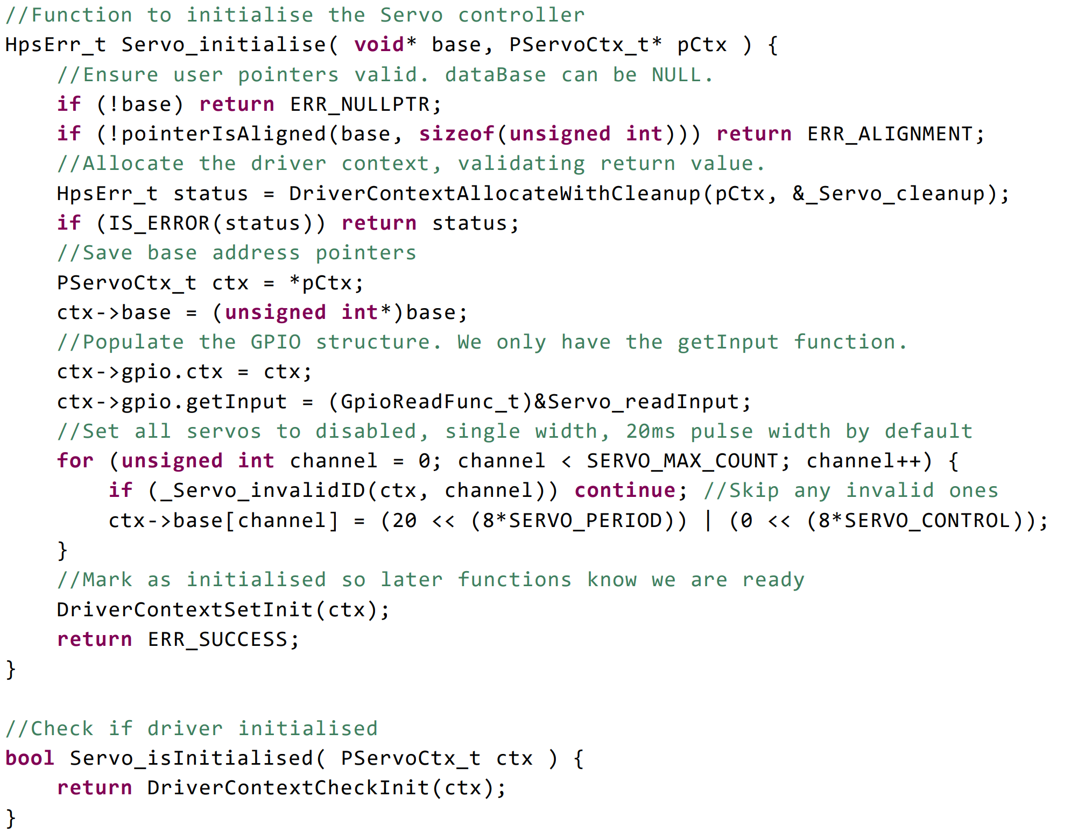
Servo Driver Initialisation functions DE1SoC_Servo.c

Slide 30
Servo Driver Initialisation functions DE1SoC_Servo.c

Slide 31
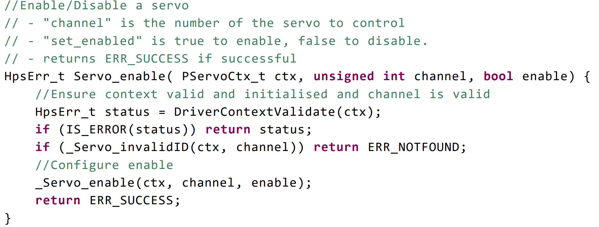
Servo Driver User Facing Enable Function

Slide 32
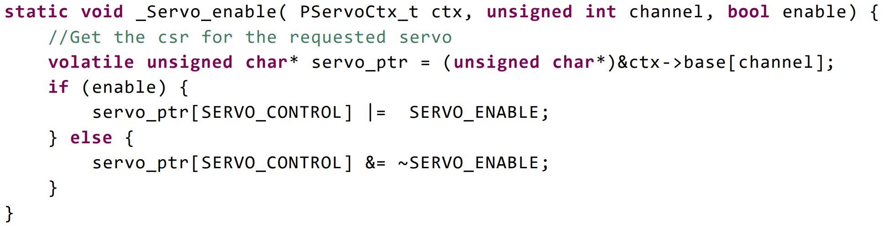
Servo Driver User Facing Enable Function

Slide 33
Pointer, addresses and arrays
volatile unsigned char* servo_ptr = (unsigned char*)&ctx->base[channel]; //Array notation
volatile unsigned char* servo_ptr = (unsigned char*)&(ctx->base[channel]); //Brackets clarify address
volatile unsigned char* servo_ptr = (unsigned char*)&*(ctx->base); //Without array of base addresses
array_value: (ctx->base[channel]);
array_address: &(ctx->base[channel]);
pointer_value: *(ctx->base);
pointer_address: &*(ctx->base);

Slide 34
Servo Driver User Facing Enable Function
Manipulation of servo_ptr value will directly update the
memory mapped peripheral!!!

Slide 35
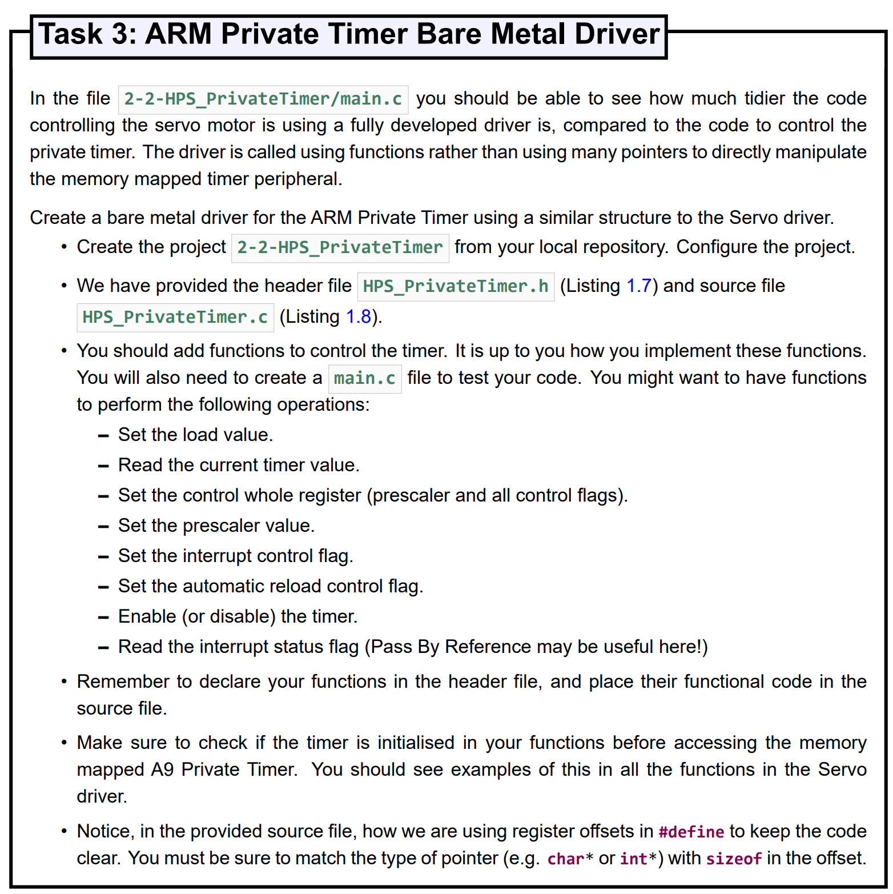
Main Task
//Read Back Current Value from A9 Timer
HpsErr_t Timer_currentValue( PTimerCtx_t ctx, unsigned int* value);
How can we read a value when our return value is an error flag?

Slide 36
Returning multiple values - Pass by Reference
unsigned int swap(int* a, int* b)
{
// Access input arguments values using pointers
int temp = *a;
*a = *b; //Manipulate pointer values
*b = temp;
return 0; //Return success
}
...
int main(void)
{
int x = 123;
int y = 456;
swap(&x, &y); // Pass address of variables as inputs to function
// Now, x=456 & y=123
return 0;
}

Slide 37
Return currentValue using - Pass by value
PTimerCtx_t timerCtx;
unsigned int timerCurrentValue;
...
exitOnFail(
Timer_currentValue(timerCtx, &timerCurrentValue), //Enable Timer Controller
ERR_SUCCESS); //Exit if not successful
//Read Back Current Value from A9 Timer
HpsErr_t Timer_currentValue( PTimerCtx_t ctx, unsigned int* value) {
HpsErr_t status = DriverContextValidate(ctx);
if (IS_ERROR(status)) return status;
// Read the Current Timer Value.
volatile unsigned int* timer_ptr = (unsigned int*)&ctx->base[0];
unsigned int temp;
temp = timer_ptr[TIMER_VALUE];
*value = temp;
return ERR_SUCCESS;
}

Slide 38
Questions?

